Slide 1

Understanding Python Strings - Part 1
Session 3
November 2025
AI Foundations - Learning Python

Slide 2
Python String Basics
• Python built-in string class: str
• Python strings are defined using single or double quotes and support escaping special characters with a backslash. Commonly single quotes.
◦ Example: '\n' for newline
◦ “I didn't do it” → example of a single quote inside a double-quoted string; vice versa okay
• Python strings are immutable; this means they cannot be changed after their creation.
◦ Operations like concatenation create new strings
◦ Example: 'hello' + ' world' results in 'hello world'

Slide 3
String spanning multiple lines
• String literals can span multiple lines when enclosed in triple quotes in Python.
◦ Triple quotes can be either single ‘’’ or double “””
◦ Allow for more readable multiline strings

Slide 4
Accessing Characters in Strings
• Individual characters in a string can be accessed using zero-based indexing with square brackets.
◦ Example: 'hello'[1] returns 'e'
◦ Indexing is similar to languages like Java and C++
• Python raises an error when an index is out of the bounds of the string length.
◦ Prevents accessing non-existent characters
◦ Python stops execution with an error

Slide 5
len() function
• The len() function returns the number of characters, which is applicable to any sequence type.
◦ Example: len('hello') returns 5
◦ Works on lists, strings, and other sequence types

Slide 6
String Concatenation and Conversion
• The '+' operator is used to concatenate strings, but it does not convert other types implicitly.
◦ Example: 'hello' + ' world' results in 'hello world'
◦ Intended for combining string objects
• To concatenate numbers or non-string types, use the str() function to convert them to string.
◦ Example: str(3.14) converts a float to '3.14'
◦ Crucial for ensuring consistent string data type

Slide 7
Code Example: Indexing, Length, Concatenation
s = 'hi'
print(s[1]) ## i
print(len(s)) ## 2
print(s + ' there') ## hi there
Open up terminal.
Run nano ./string1.py
Solve problem A. donuts

Slide 8
Chapter Two

Slide 9
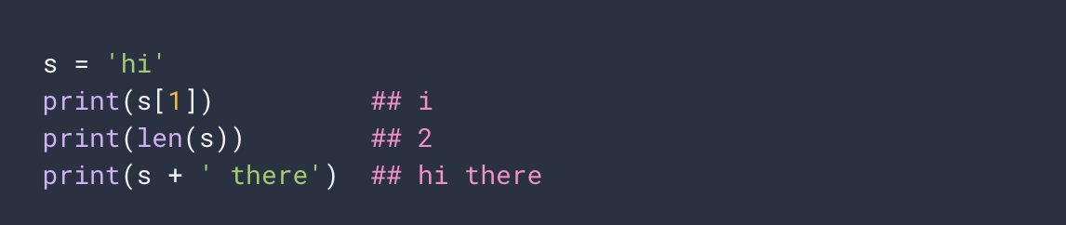
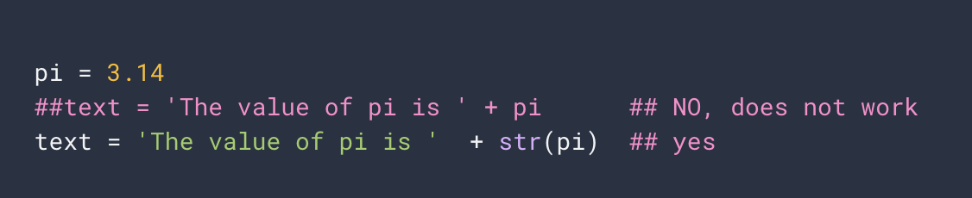
Code Example Refresher: [], len(), +, str()

Slide 10
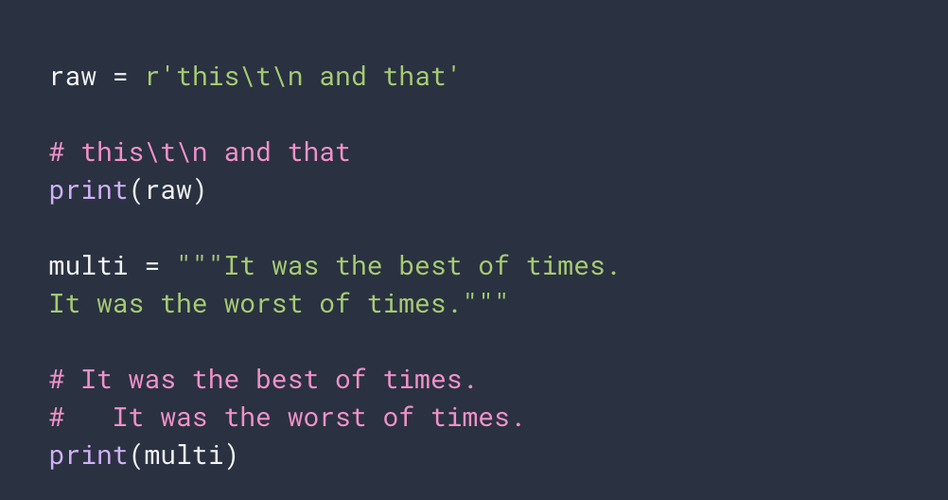
Code Example Refresher: r’ and “””

Slide 11
Nano commands: Try these!
FILE
Ctrl O : Save a file
Ctrl X : Exit
NAVIGATION
Ctrl W : Find a word
Ctrl Y : Prev Page
Ctrl V : Next Page
Ctrl C : Current Cursor Position
EDITING
Ctrl J : Justify (Hard Word Wrap)
Ctrl U : Unjustify
Ctrl - Shift - 6 (Ctrl ^) : Mark text selection
Ctrl K : Cut Text
Ctrl U : Paste Text

Slide 12
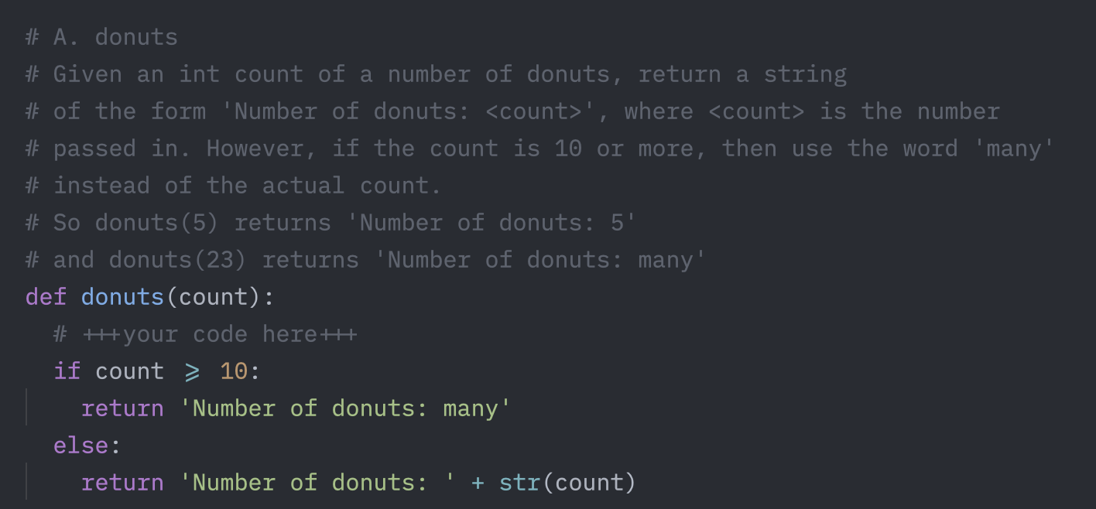
The Donuts Problem

Slide 13
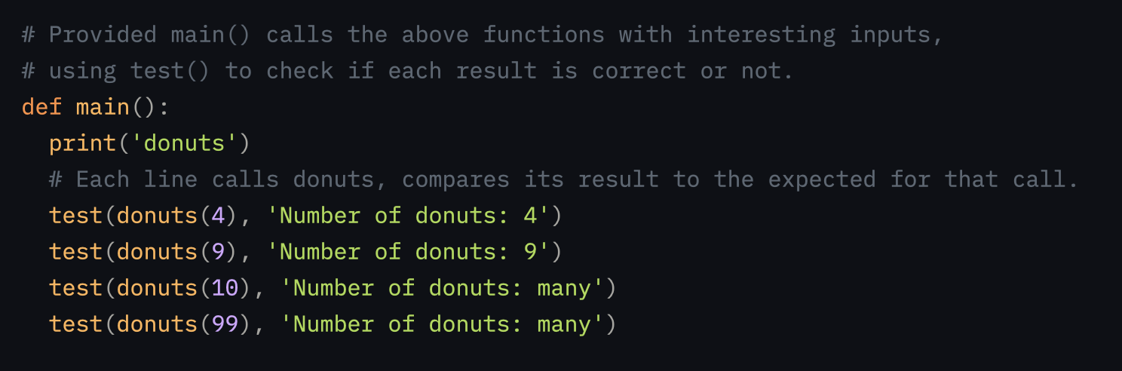
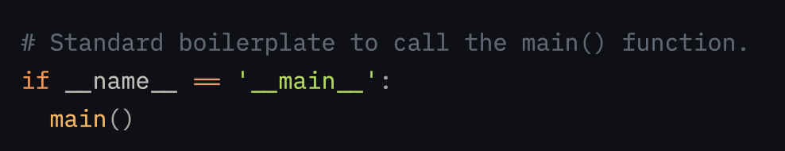
The Main function

Slide 14
Chapter Three

Slide 15
Base 10 (Decimal) versus Base 2 (Binary)
Base 10 is 10 digits (0 to 9), matches human fingers.
Base 2 has only 2 digits (0 or 1), matches computers on/off voltage
_3_ _4_ _5_ = (3 * 100) + (4 * 10) + (5 * 1) = 345
10² 10¹ 10⁰
_1_ _0_ _1_ = (1 * 4) + (0 * 2) + (1 * 1) = 5
2² 2¹ 2⁰
4
2
1

Slide 16
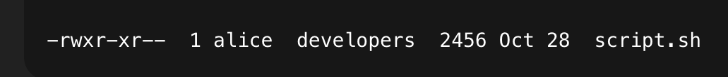
Setting permissions with chmod
111 101 100
= 7 5 4 (Base 8 - Octal)
rwx rwx rwx
r = read
w = write
x = execute
user (alice) group (developers) others (everyone else)
u
g
o
chmod +x script.sh
chmod u+x script.sh
chmod o-x script.sh
chmod 755 script.sh

Slide 17
String Methods Overview
• Python strings come with many built-in methods for common operations and checks.
◦ Facilitates easy manipulation of string data
• These methods help convert case, check characteristics, and find or replace string contents effectively.
◦ s.lower(), s.upper()
◦ s.isalpha(), s.isdigit(), s.isspace()
◦ s.startswith('other'), s.endswith('other')
◦ s.find('other')

Slide 18
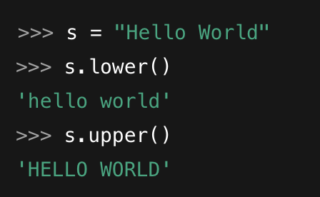
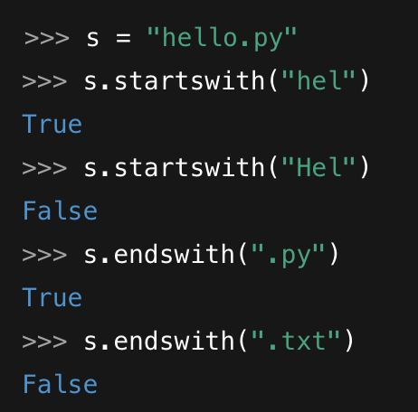
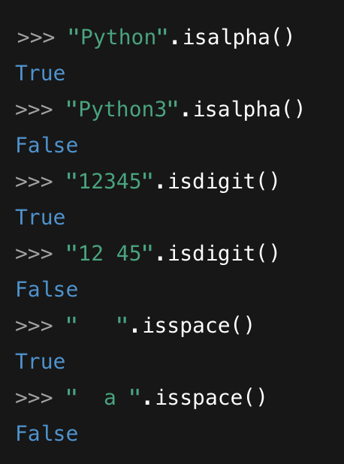
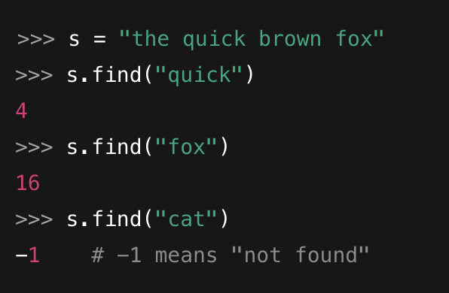
Practice String methods in the interpreter
lower, upper
startswith, endswith
isalpha, isdigit, isspace
find

Slide 19
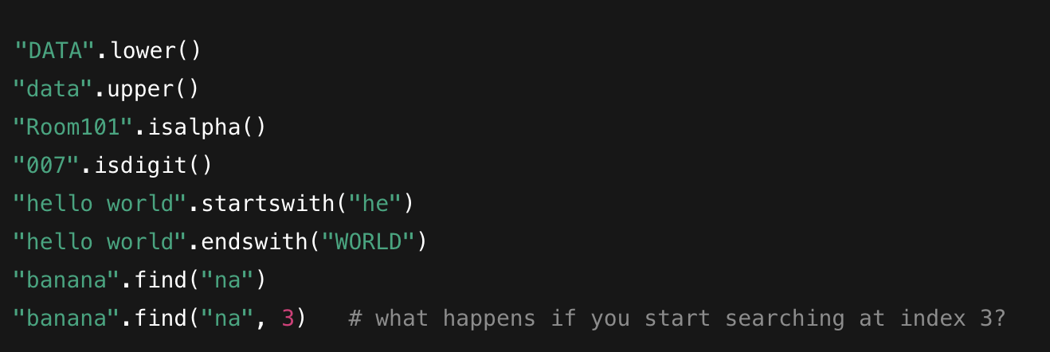
Practice String methods (cont’d)
Predict the output for each line.

Slide 20
More String Methods Examples
◦ Example: s.strip() removes surrounding whitespace
◦ s.replace('old', 'new') changes substrings
• Methods such as s.split(‘delim’) and s.join(list) provide powerful tools for working with delimited data.
◦ Split breaks string at the delimiter into a list
◦ Join combines list items into a single string

Slide 21
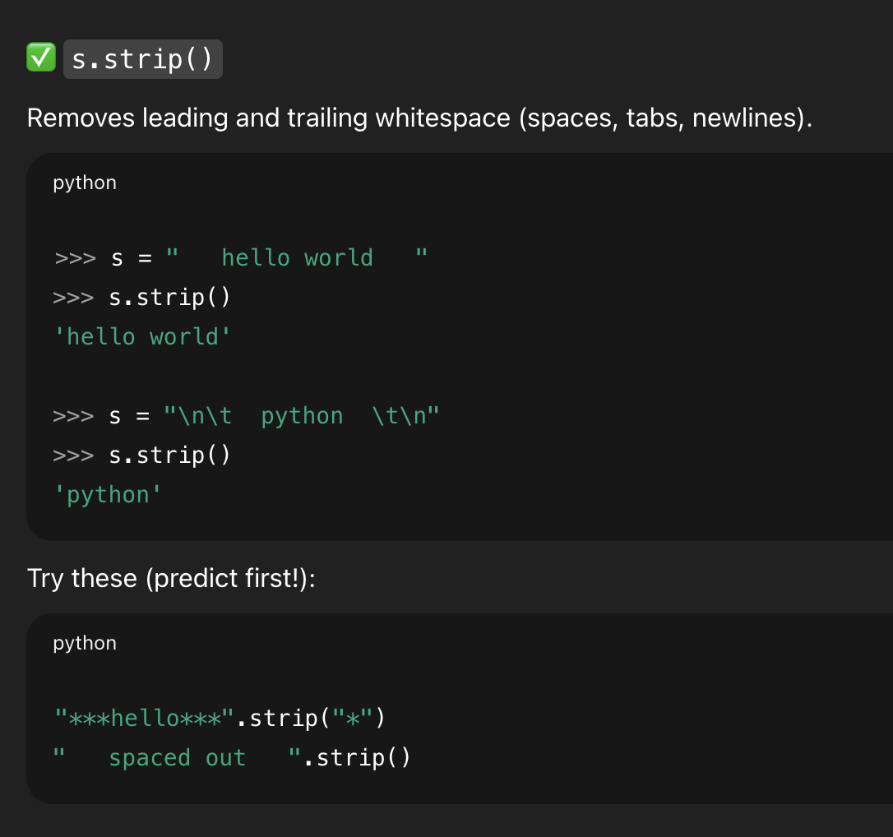
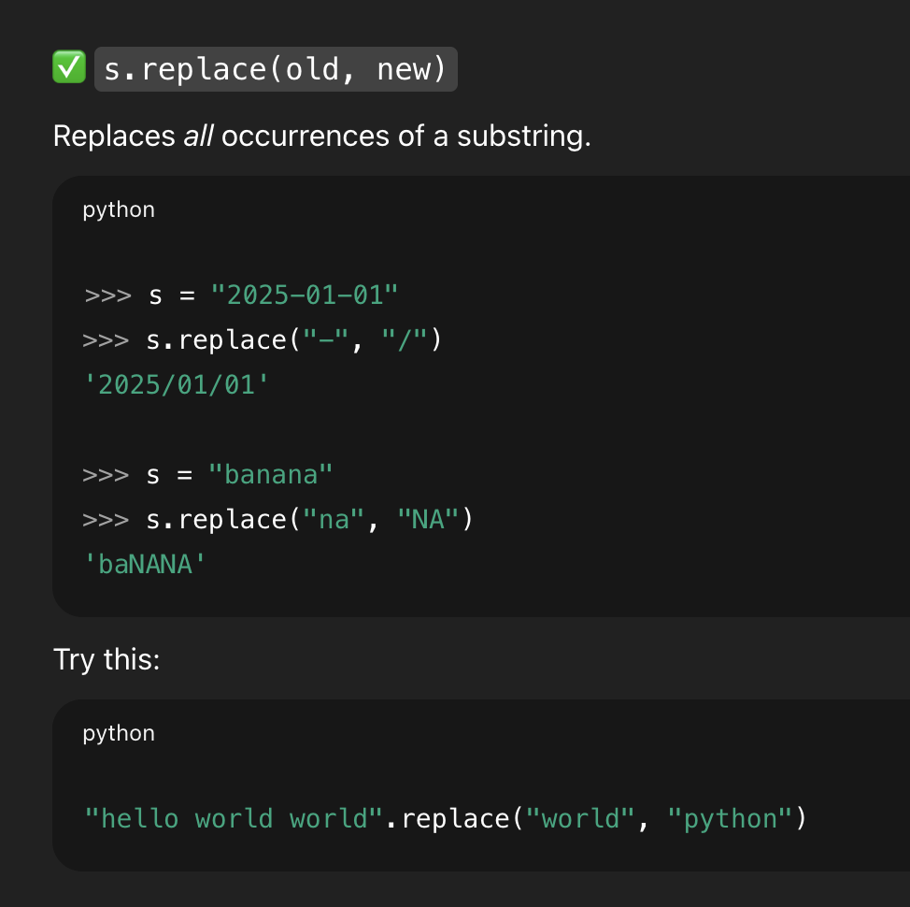
strip & replace

Slide 22
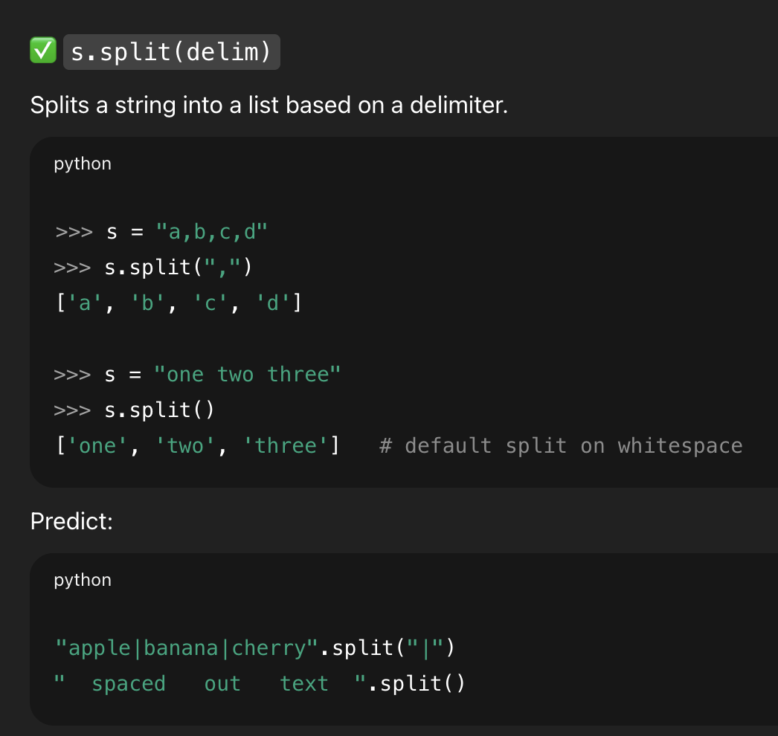
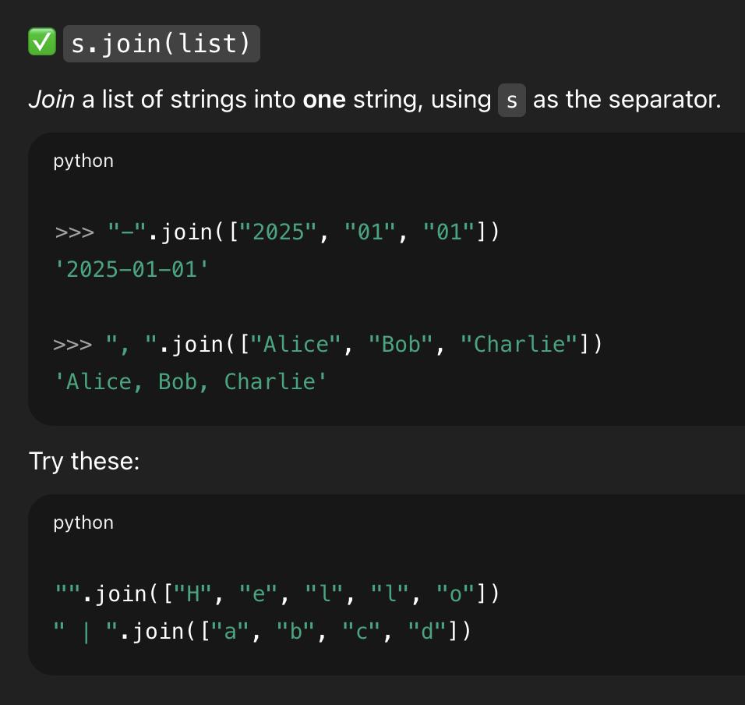
split & join

Slide 23
Predict the outputs:
" python ".strip()
"mississippi".replace("ss", "SS")
"1-2-3-4-5".split("-")
".".join(["www", "example", "com"])
"-".join("ABC")
",".join("12345")
"".join(" ".split())
".".join("hello".upper().split("L"))
how many list elements?
"-".join("banana".split("na"))
"".join(" a b c ".strip().split())
",".join(" 1 2 3 ".strip().split(" "))
"X".join("".replace("", "?"))

Slide 24
Using Slice Syntax with Strings
• Slices allow you to refer to sub-parts of sequences like strings, using start and end indices.
◦ Syntax: s[start:end]
◦ Does not include the 'end' index character. Why not?
• Omitting start or end in slice defaults to beginning or end of the string, respectively, allowing flexibility.
◦ s = ”Hello”
◦ s[1:] gives 'ello' (from index 1 onward)
◦ s[:3] gives 'Hel' (up to index 3)

Slide 25
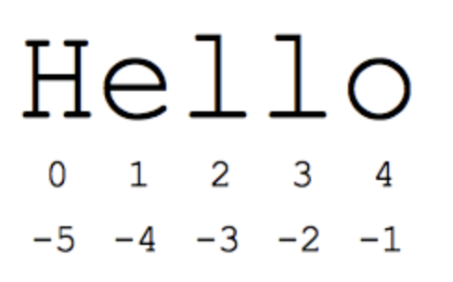
Slice Syntax with Strings: Negative Indices
• Negative indices can be used to refer to positions from the string's end, simplifying reverse-order access.
◦ s[-1] is the last character 'o'
◦ s[-2:] provides the last two characters
Give two ways to get ‘el’

Slide 26
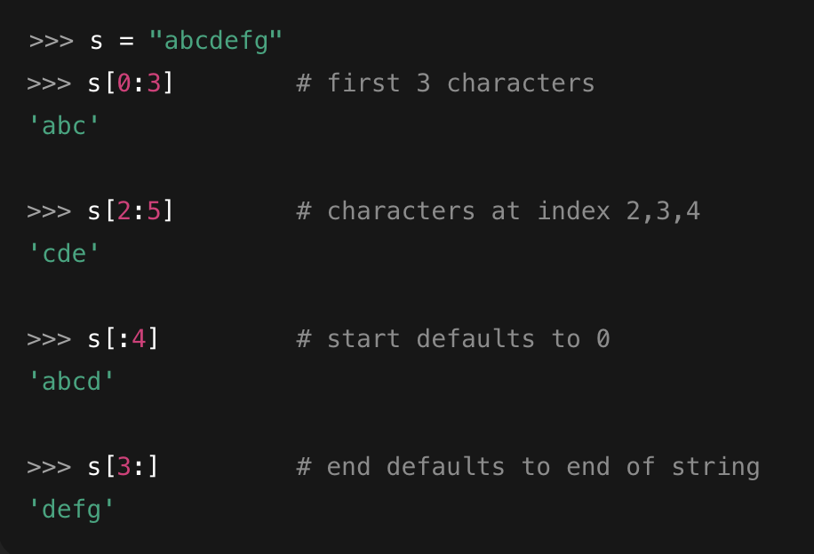
Code Example: String Slice and Access
s = 'Hello'
s[1:4] # 'ell'
s[1:] # 'ello'
s[:3] # 'Hel'
s[-1] # 'o'
◦ Illustrates using slices for string manipulation
◦ Highlights Python's flexibility with indices

Slide 27
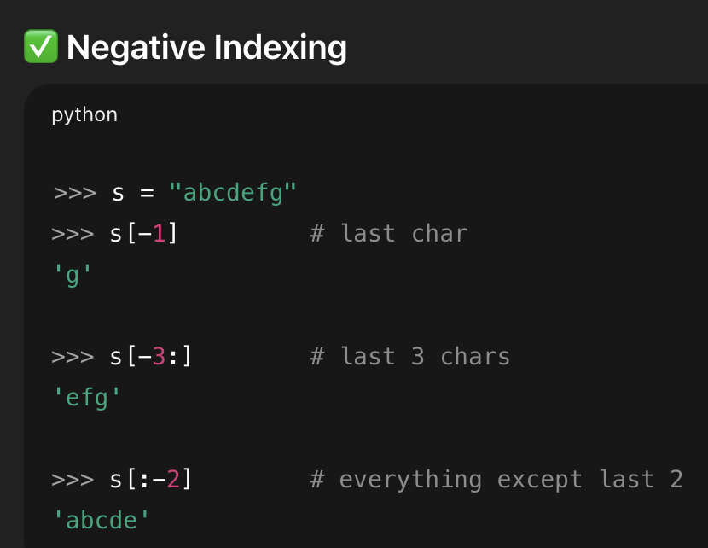
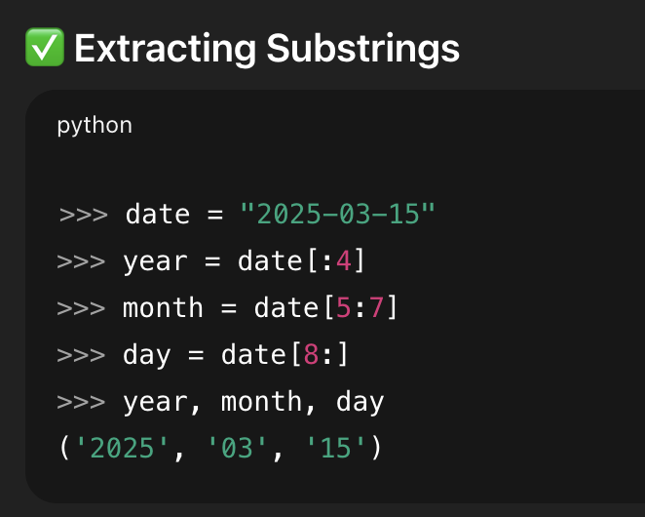
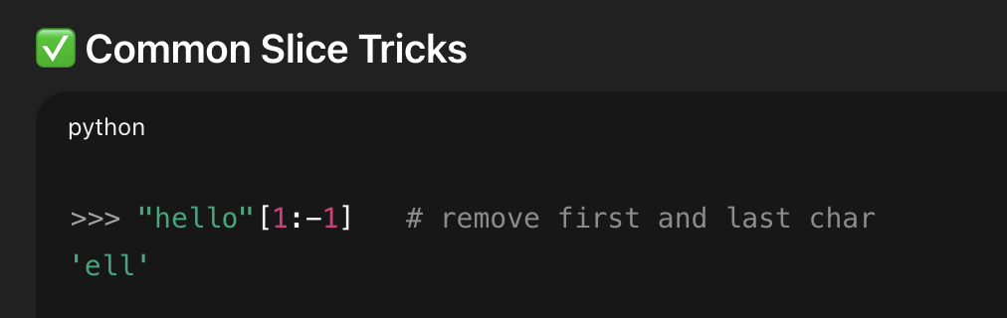
Slice techniques

Slide 28
Slice Exercises [Run in Interpreter]
Extract the file extension file = "document.final.v3.pdf"
Remove the file extension above.
Get only the year date = "2025-11-20"
Extract the user name from the email email = "testuser@example.com"
Extract last four digits of credit card number card = "5123456789012345"
Drop first and last character s = "[hello]"

Slide 29
Answer Key
file[-3:]
file[:-4
date[:4]
email[:8] => email[:email.find(‘@’)]
card[-4:]
s[1:-1]

Slide 30
Coding Exercises with Strings
Download Zed.
https://zed.dev/
Don’t authenticate/sign-in yet.
Now open up string1.py in Zed
Solve problem B. both_ends
Solve problem C. fix_start
Solve problem D. mixup

Slide 31
End of Part One

